Slide 1
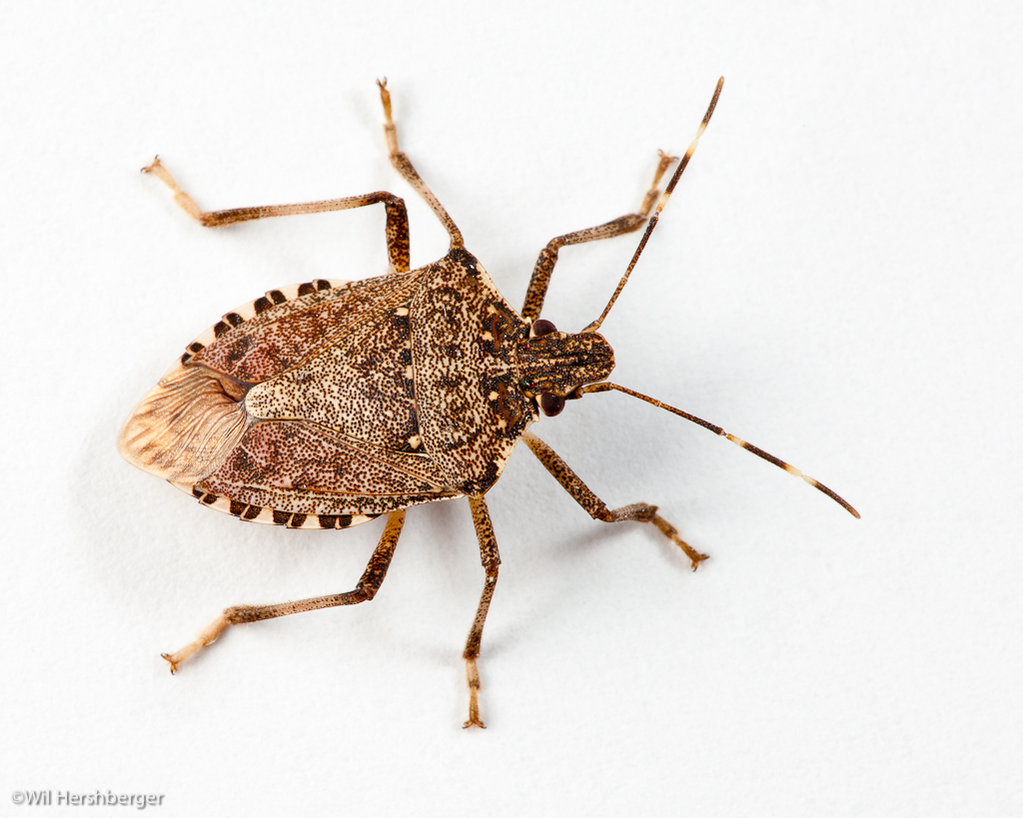
Utilizing Citizen Science to Identify Characteristics Important to Overwintering Site Selection for Brown Marmorated Stink Bug
Torri J. Hancock, Doo-Hyung Lee,
J. Christopher Bergh, Rob Morrison,
and Tracy C. Leskey
BMSB Working Group - June 9, 2015

Slide 2
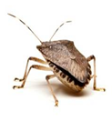
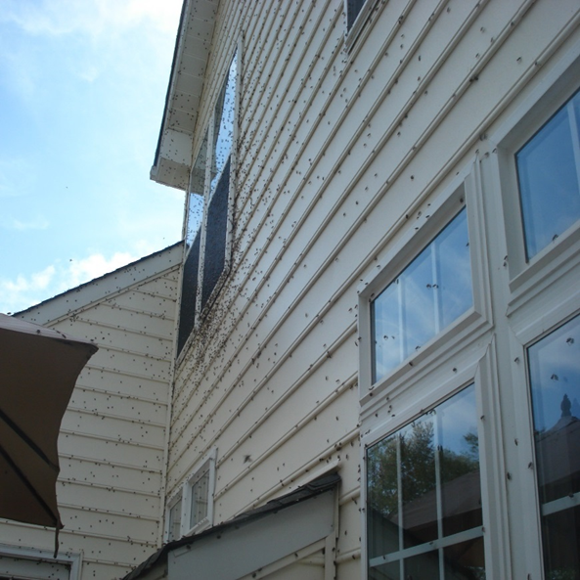
Background
Brown marmorated stink bug (BMSB), Halyomorpha halys (Stål)
caused severe agricultural crop losses
become a significant nuisance pest in parts of the US
Two key events occur during the process of overwintering site selection:
dispersal to the structure
settling within the structure
(Inkley, 2012)
Notes:
Brown marmorated stink bug is an invasive insect that has caused severe agricultural crop losses. It has also become a significant nuisance pest in parts of the United States. Homeowners consider the insect to be a nuisance because BMSB often enter homes by the thousands during the fall when seeking a spot to spend the winter.
Two key events occur during this process: 1) dispersal to the structure, and 2) settling within the structure. A preliminary study, that Doug Inkley spoke about earlier, focused on the settling aspect of overwintering site selection.

Slide 3
Identifying the Problem
Overwintering site selection
Characteristics of natural locations have been identified (Lee, et al., 2014)
Characteristics identified when BMSB settle within the structure (Inkley, 2012)
No published studies examining dispersal to structure
Research Question:
What are the specific characteristics associated with human-made structures that are important when BMSB are dispersing to overwintering sites?
Notes:
Characteristics of overwintering sites selected by BMSB have been identified for natural areas, and include preference for large, dry, dead standing trees. We have another study that Doug just described regarding BMSB that have settled within a structure. There have been no published studies examining BMSB dispersal to human-made structures. We have posed the following research question: What are the specific characteristics associated with human-made structures that are important when BMSB are dispersing to overwintering sites? For example, could color and aspect be important considerations?

Slide 4
Citizen Science
Allows for gathering large amounts of data
Well-known citizen science projects
National Audubon Society’s Christmas Bird Count
UK Butterfly Monitoring Scheme
Notes:
So, the question is how can we gather enough data on BMSB dispersal to overwintering sites to effectively address this question. Citizen science is a crowd-sourcing technique that utilizes the public to gather scientific information from a large number of individuals in a short amount of time. Well-known citizen science projects include the National Audubon Society’s Christmas Bird Count and the UK Butterfly Monitoring Scheme.

Slide 5
Materials and Methods
A survey was developed
Questionnaire
Data sheet
Participants recruited via NPR, newspaper articles, websites including www.stopbmsb.org, outreach
Participants were asked to complete and return data forms
Notes:
A survey was developed that utilized a questionnaire and data sheet to gather information from volunteers. Participants were recruited via NPR, newspaper articles, the stopBMSB website, and other outreach opportunities at AFRS. Participants were asked to complete and return their data forms, which I will show next.

Slide 6
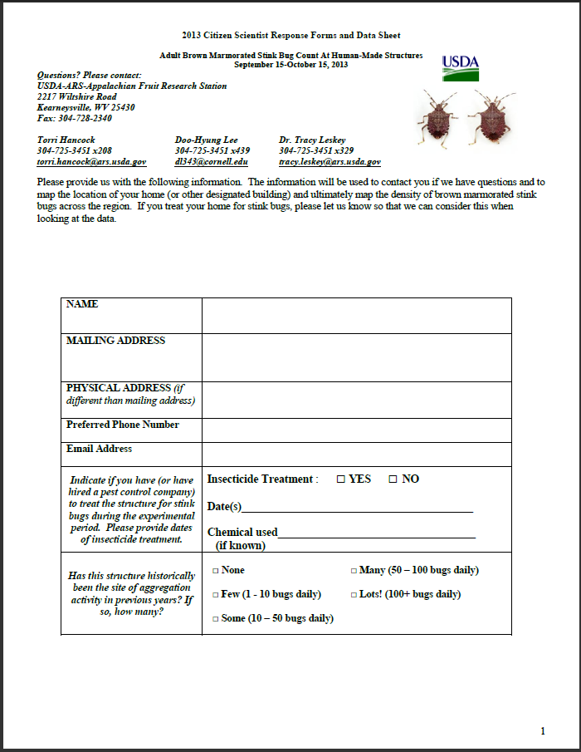
Notes:
Name and physical address were requested, along with contact information. We also asked if they had treated their home previously with insecticide, and asked for the history of BMSB pressure at their location.

Slide 7
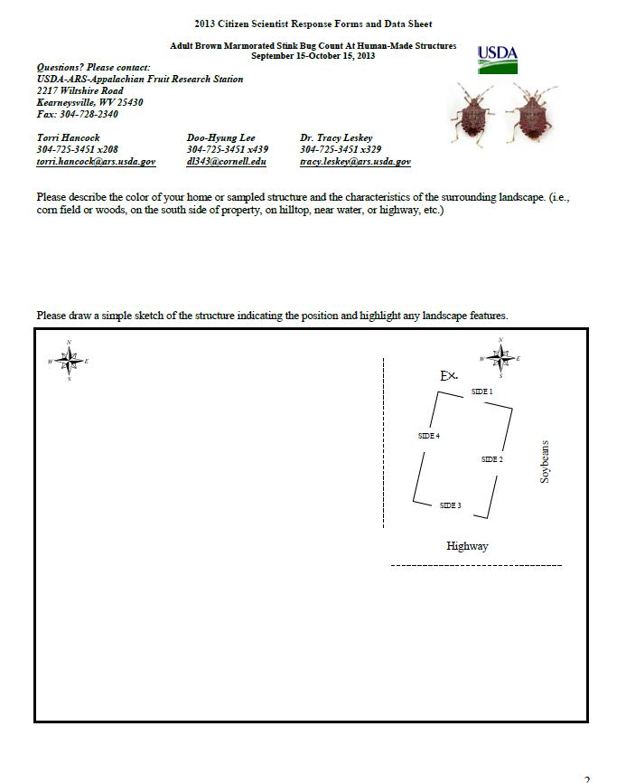
Notes:
Page 2 asks for a sketch of the sampled structure and for a description of the structure and surrounding landscape features.

Slide 8
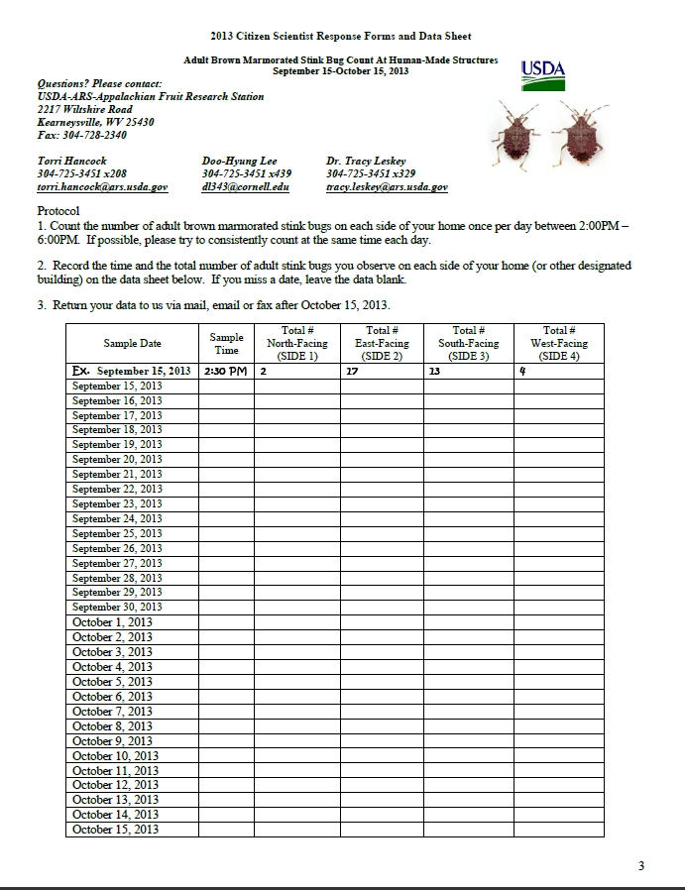
Notes:
A data sheet was provided for daily counts of BMSB on the structure’s exterior for each cardinal direction from September 15-October 15, which is during peak dispersal period in the fall. Counts were requested to be performed between 2-6pm.

Slide 9
Data Validation
Criterion 1: data set must contain at least 16 completed dates during the 31 day sampling period
Criterion 2: data set must contain a peak activity date that corresponds with:
1) One of the top five dates for peak website hits on StopBMSB.org for the homeowner’s corresponding state AND
2) One of the top five days of activity based on daily BMSB counts on the exterior walls performed by Chris Bergh’s lab group at his research station in Winchester, VA
Notes:
We conducted this study in 2013 and 2014. Today, I’m only going to present the 2013 data and take you through how we validated the data. Several criteria were used for selecting data sets to include in the final analysis to ensure that we were confident in the numbers our citizen scientists were reporting. Criterion 1: data set must contain at least 16 completed dates for the 31 day sampling period.
Criterion 2: data set must contain a peak activity date that corresponds with: one of the top five peak adult activity dates in comparison with 1) the 5 days with the top amount of hits from the stopBMSB website for each homeowner’s corresponding state, and 2) the top five days of peak adult activity based on daily counts performed by Chris Bergh at his research station in Winchester, VA.

Slide 10
Valid Data Sets
299 submitted
137 data sets excluded
Total of 162 utilized for analysis from:
MD ● PA
VA ● GA
WV ● NC
● OH
Notes:
Of the 299 data sets submitted, 137 data sets were excluded, for a total of 162 being used in the analysis.

Slide 11
Data Analysis
Separate analyses of variance (ANOVAs) created for each variable (not all variables provided by each participant)
Explanatory variables included:
structure color
exterior structure material
aspect
landscape
Data were not normally distributed and were log-transformed
Tukey’s HSD used for pairwise comparisons
α = 0.05
Notes:
Separate ANOVAs were created for each variable because not all variables were provided by each participant. Variables consisted of: structure color, exterior structure material, aspect, and landscape. Data were not normally distributed and were log-transformed. Tukey’s HSD test was used for comparisons, with the significance level of 0.05

Slide 12
Results - Color
Notes:
On the Y axis is the mean number of BMSB counted per homeowner. On the X axis is the exterior color reported by homeowners. Interestingly, we found that the greatest counts were recorded on brown homes, which was in contrast to what we often hear from homeowners.

Slide 13
Results – Structure Material
Notes:
Exterior structure material also yielded significant differences in counts; homes with wood or stone exterior had significantly higher counts compared with all other materials except cement. However, you will note there is a lot of variation.

Slide 14
Results - Aspect
Notes:
Aspect – whether more BMSB were showing up on the N, S, E or W sides of homes. This also yielded significant differences; greatest counts were recorded on the north side of structures while significantly fewer were on the south side.

Slide 15
Results - Landscape
Notes:
Among landscapes, significantly greater counts were recorded in rural areas compared with urban settings.

Slide 16
Results – Peak Activity
Notes:
So, last up, I wanted to show you peak activity – the dates when homeowners recorded the greatest number of BMSB on the exterior of their structure throughout the sampling period. On the Y axis is the total number of participants and on the X is the date. Peak activity reported by participants was during a very narrow window, from September 30-October 2 in 2013.

Slide 17
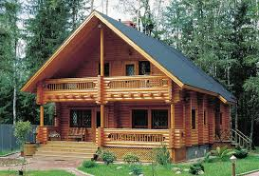
Conclusions
2013 only
Structure color: brown
Exterior structure material: wood, stone
Landscape type: rural
Peak date: October 1, 2013
Notes:
These are only tentative conclusions because this data set represents 2013 only. Based on the 2013 data, we found that the color of home with greatest number of BMSB counted was brown, that the material types with greatest number of BMSB counts were: wood and stone, the most BMSB were counted in rural landscape types, and the peak date of BMSB activity was October 1st in 2013.

Slide 18
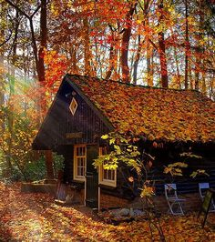
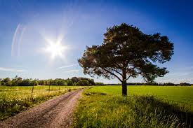
Next Steps
Risk factors can be considered (color, material, aspect, landscape, date)
2014 CitSci Project in progress
Peer-review journal article will be developed with data from 2013 and 2014
Notes:
There are factors that can be considered by homeowners when implementing exclusion tactics or other techniques to reduce indoor infestations of BMSB. The 2014 data set is being processed. We are hoping to develop a peer-reviewed journal article with data from both 2013 and 2014.

Slide 19
Acknowledgements
This project was supported by:
USDA NIFA OREI Grant # 2012-51300-20097 Whole Farm Organic Management of BMSB and Endemic Pentatomids through Behavior-Bases Habitat Manipulation
USDA-NIFA SCRI Grant # 2011-51181-30937 Biology, Ecology, and Management of Brown Marmorated Stink Bug in Orchard Crops, Small Fruit, Grapes, Vegetables and Ornamentals
Committee Members:
Tracy C. Leskey, USDA-ARS, Appalachian Fruit Research Station
J. Christopher Bergh, Virginia Tech-VAES Agricultural Research and Extension Center
Doug Pfeiffer, Virginia Tech-College of Agriculture and Life Sciences
Statistics and Technical Assistance:
Rob Morrison, USDA-ARS, Appalachian Fruit Research Station
Doo-Hyung Lee, Gachon University

Slide 20
Questions?

